Slide 1
Software inspections
These involve people examining the source representation with the aim of discovering and defects.
Inspections not require execution of a system so may be used before implementation.
They may be applied to any representation of the system (requirements, design, configuration data, test data, etc.).
They have been shown to be an effective technique for discovering program errors.

Slide 2
Inspection success
Many different defects may be discovered in a single inspection. In testing, one defect ,may mask another so several executions are required.
The reuse domain and programming knowledge so reviewers are likely to have seen the types of error that commonly arise.

Slide 3
Inspections and testing
Inspections and testing are complementary and not opposing verification techniques.
Both should be used during the V & V process.
Inspections can check conformance with a specification but not conformance with the customer’s real requirements.
Inspections cannot check non-functional characteristics such as performance, usability, etc.

Slide 4
Program inspections
Formalised approach to document reviews
Intended explicitly for defect detection (not correction).
Defects may be logical errors, anomalies in the code that might indicate an erroneous condition (e.g. an uninitialised variable) or non-compliance with standards.

Slide 5
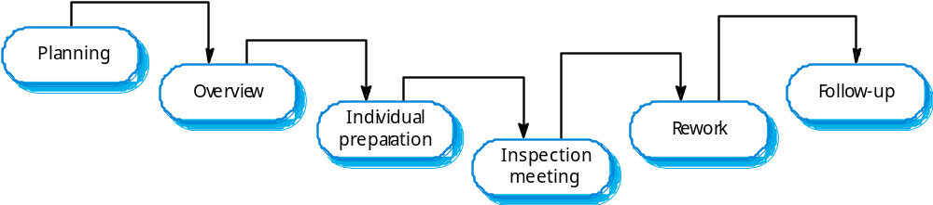
The inspection process

Slide 6
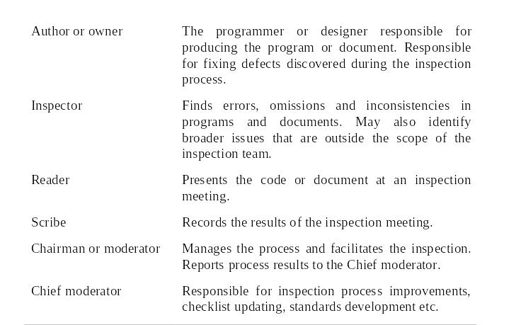
Inspection roles

Slide 7
Inspection checklists
Checklist of common errors should be used to
drive the inspection.
Error checklists are programming language
dependent and reflect the characteristic errors that are likely to arise in the language.
In general, the 'weaker' the type checking, the larger the checklist.
Examples: Initialisation, Constant naming, loop
termination, array bounds, etc.

Slide 8
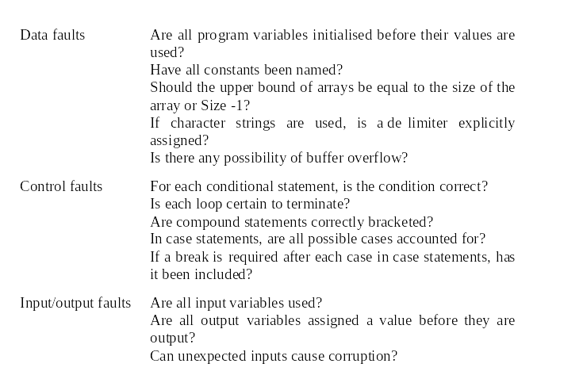
Inspection checks 1

Slide 9
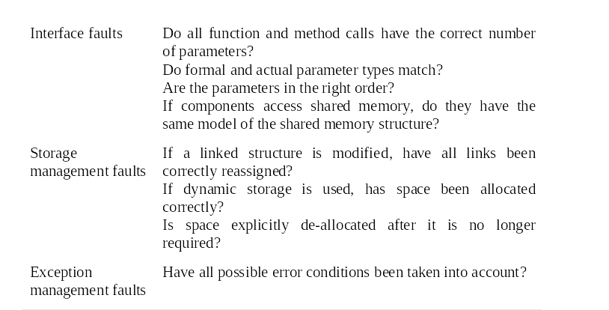
Inspection checks 2

Slide 10
Automated static analysis
Static analysers are software tools for source text processing.
They parse the program text and try to discover potentially erroneous conditions and bring these to the attention of the V & V team.
They are very effective as an aid to inspections - they are a supplement to but not a replacement for inspections.

Slide 11
Stages of static analysis
Control flow analysis. Checks for loops with
multiple exit or entry points, finds unreachable
code, etc.
Data use analysis. Detects uninitialised
variables, variables written twice without an
intervening assignment, variables which are
declared but never used, etc.
Interface analysis. Checks the consistency of
routine and procedure declarations and their
use

Slide 12
Cleanroom software development
The name is derived from the 'Cleanroom'
process in semiconductor fabrication. The
philosophy is defect avoidance rather than
defect removal.
This software development process is based on:
  Incremental development;
  Formal specification;
  Static verification using correctness arguments;
  Statistical testing to determine program reliability.

Slide 13
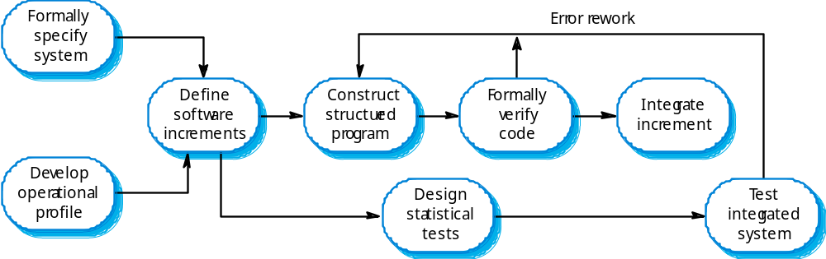
The Cleanroom process

Slide 14
Cleanroom process characteristics
Formal specification using a state transition model.
Incremental development where the customer prioritises increments.
Structured programming - limited control and abstraction constructs are used in the program.
Static verification using rigorous inspections.
Statistical testing of the system .

Slide 15
Formal specification and inspections
The state based model is a system specification and the inspection process checks the program against this mode.l
The programming approach is defined so that the correspondence between the model and the system is clear.
Mathematical arguments (not proofs) are used to increase confidence in the inspection process.

Slide 16
Cleanroom process teams
Specification team. Responsible for developing
and maintaining the system specification.
Development team. Responsible for
developing and verifying the software. The
software is NOT executed or even compiled
during this process.
Certification team. Responsible for developing
a set of statistical tests to exercise the software
after development. Reliability growth models
used to determine when reliability is acceptable.

Slide 17
Cleanroom process evaluation
The results of using the Cleanroom process have been very impressive with few discovered faults in delivered systems.
Independent assessment shows that the
process is no more expensive than other
approaches.
There were fewer errors than in a 'traditional' development process.
However, the process is not widely used. It is not clear how this approach can be transferred
to an environment with less skilled or less
motivated software engineers.

